Slide 3
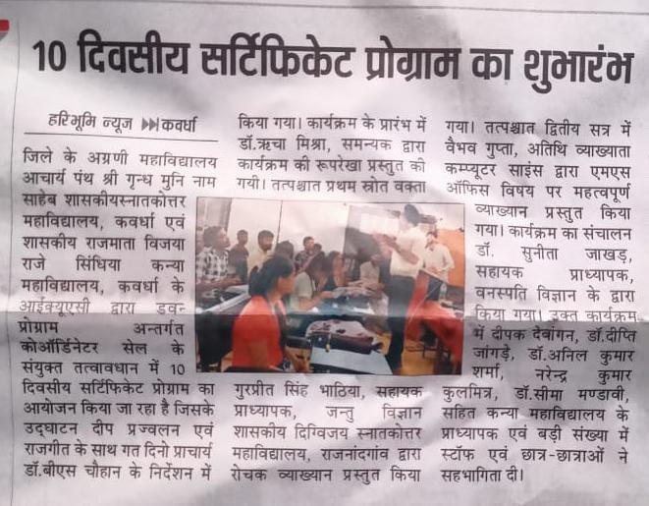

Slide 4
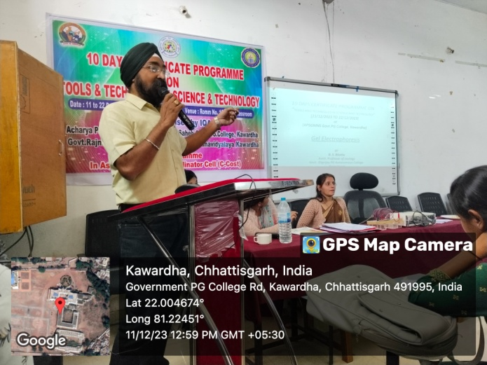
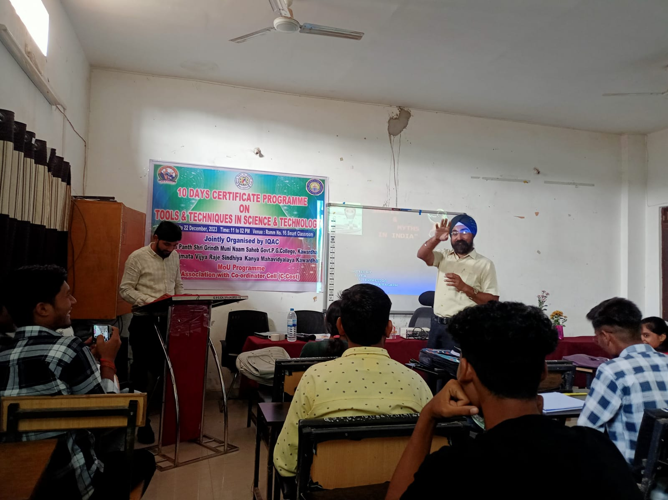
DAY FIRST 11.12.2023
LECTURE BY - Mr. Gurpreet singh Bhatiya , Asistant professor
Department of Zoology Govt. Digvijay P.G. College Rajnandgaon (C.G.)
Topic- Electrophoresis

Slide 5
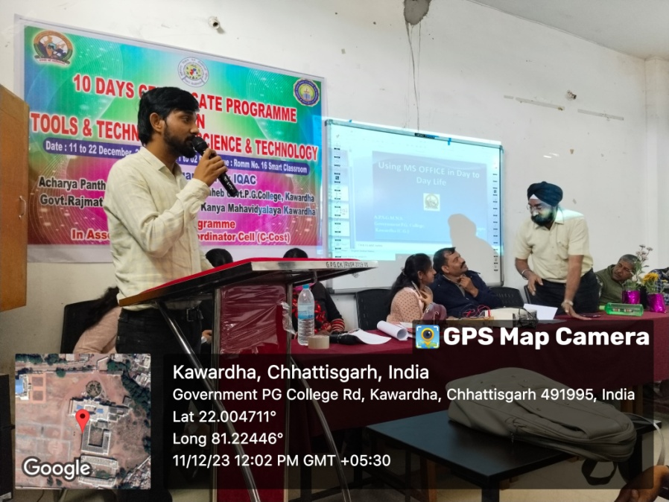
DAY FIRST 11.12.2023
LECTURE BY – Mr. Vaibhav Gupta, Guest Lecturer ,
APSGMNS Govt. P.G. College Kawardha (C.G.)
Topic- MS Office

Slide 6
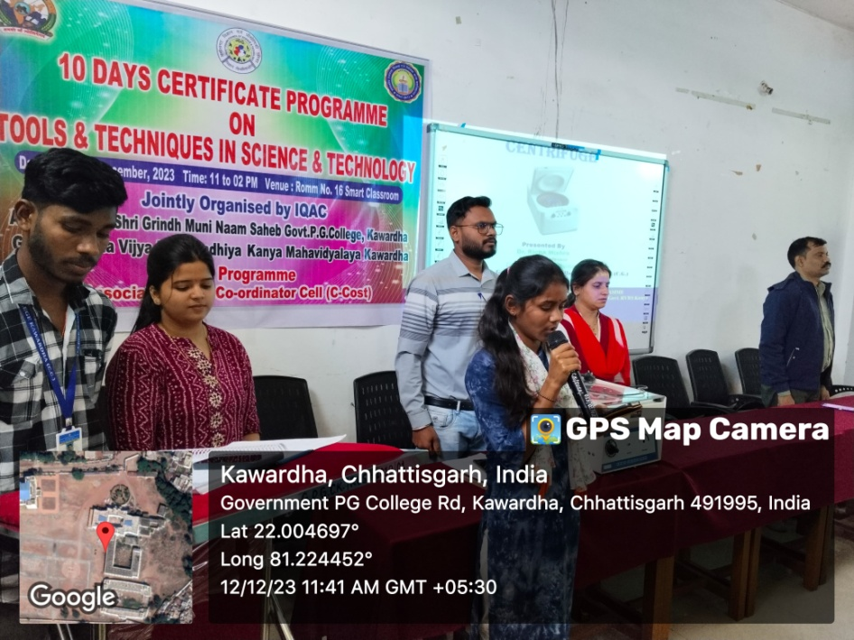
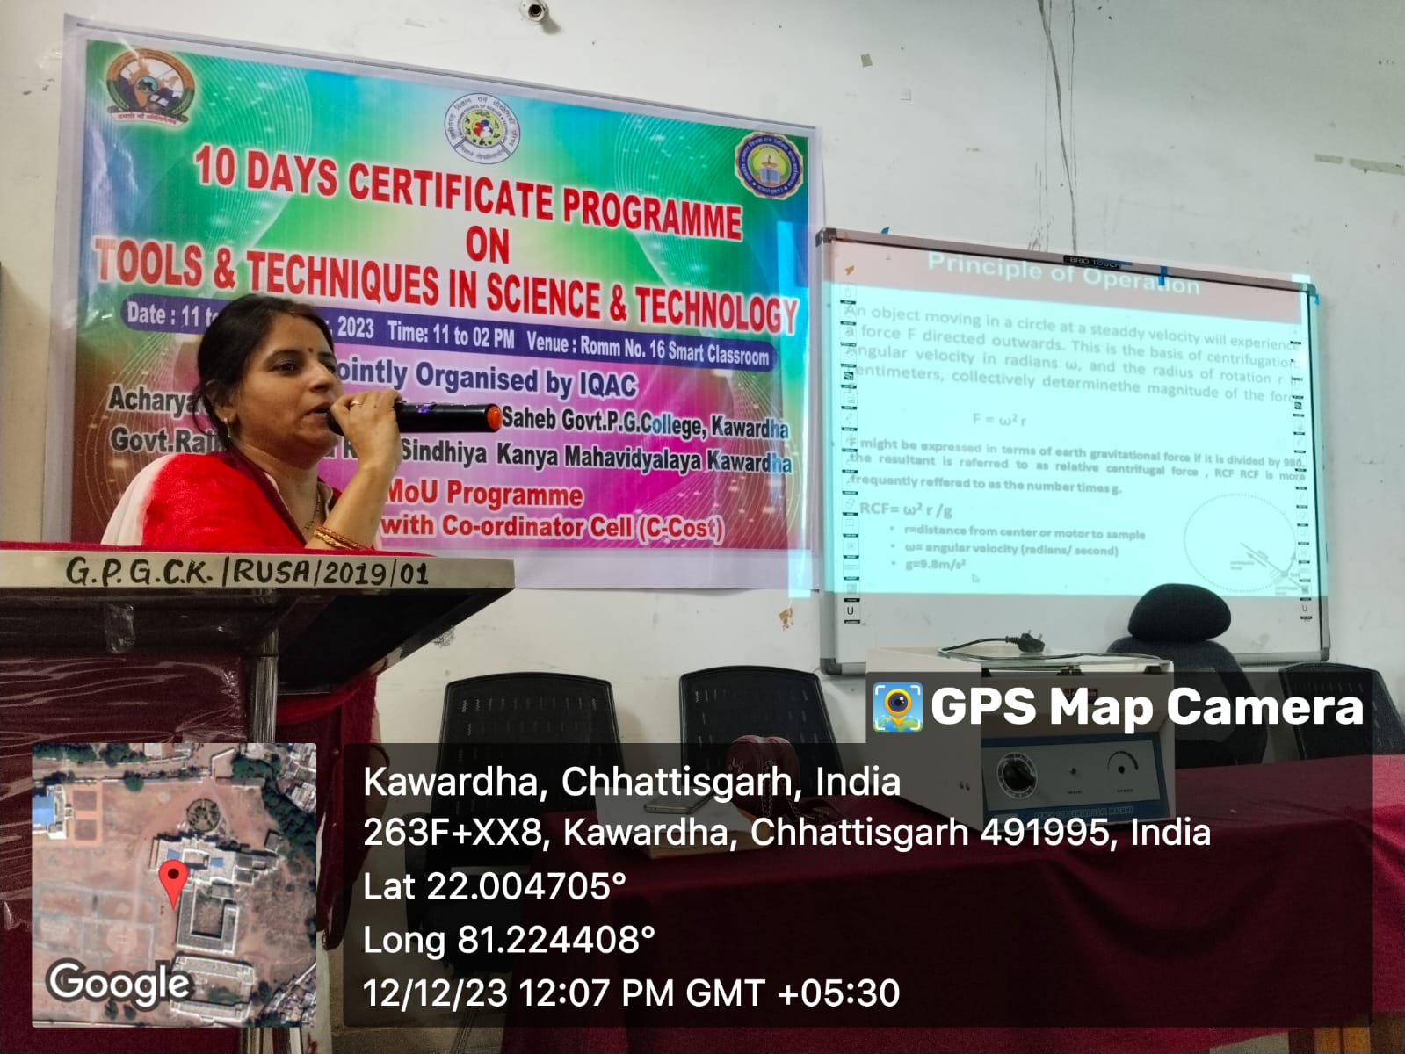
DAY SECOND 12.12.2023
LECTURE BY – Dr. Richa Mishra, Asistant professor of Microbiology
APSGMNS Govt. P.G. College Kawardha (C.G.)
Topic- Centrifuge

Slide 7
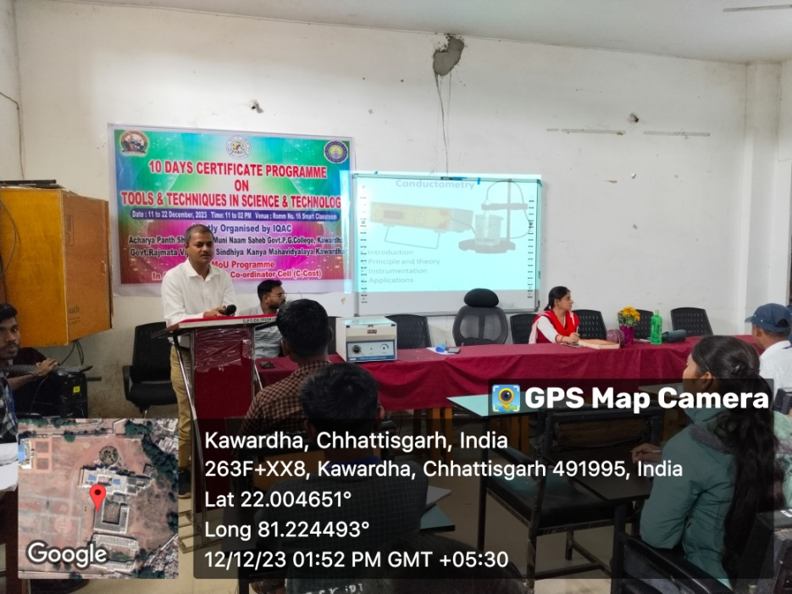
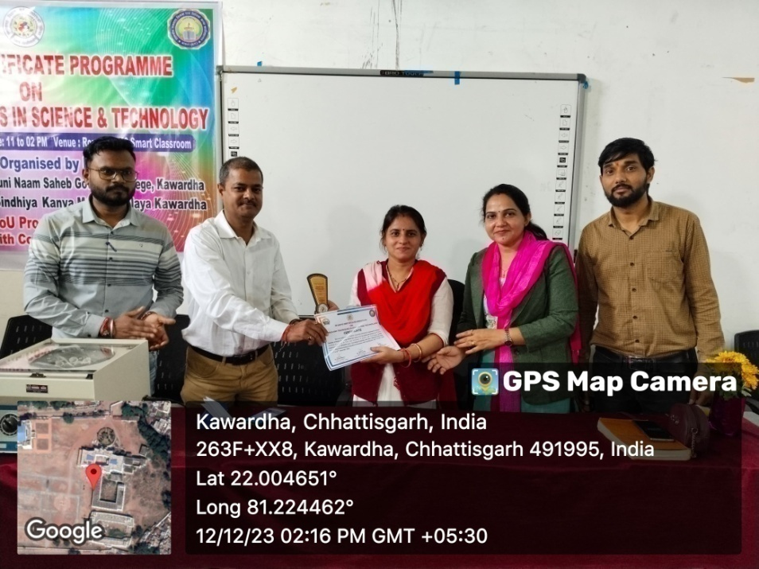
DAY SECOND 12.12.2023
LECTURE BY – Dr. Naresh Chandra Deshmukh, Asistant professor of chemistry,
Kalyan P.G. College Bhilai (C.G.)
Topic- Conductivity Meter

Slide 8
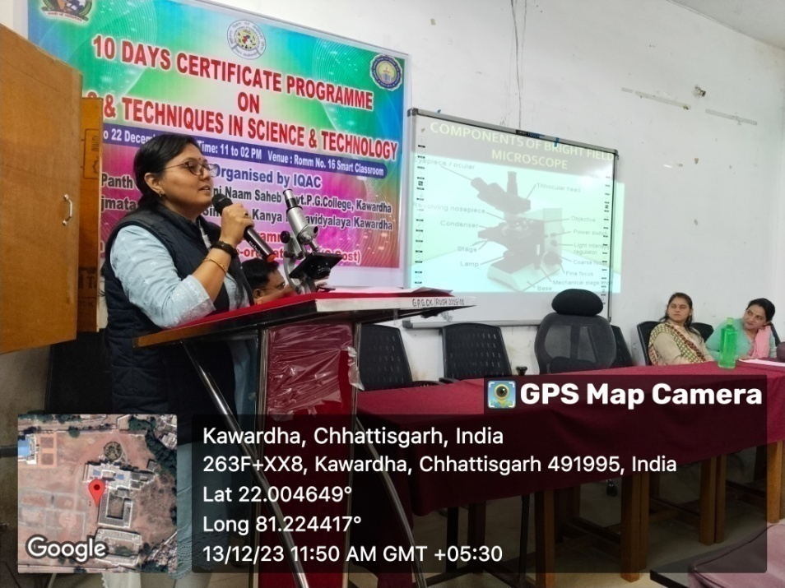
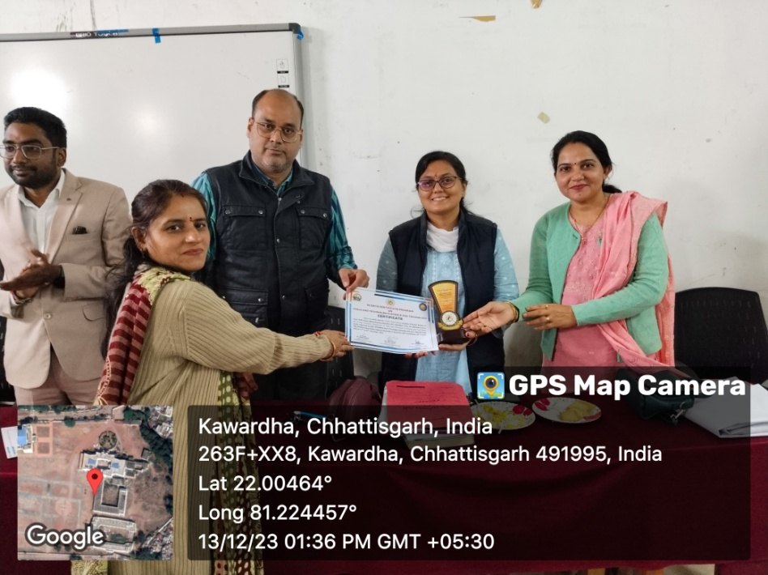
DAY THIRD 13.12.2023
LECTURE BY – Preeti Singh Parihar, Asistant professor of Botany,
Govt. RVRS Girls College Kawardha (C.G.)
Topic- Microscope

Slide 9
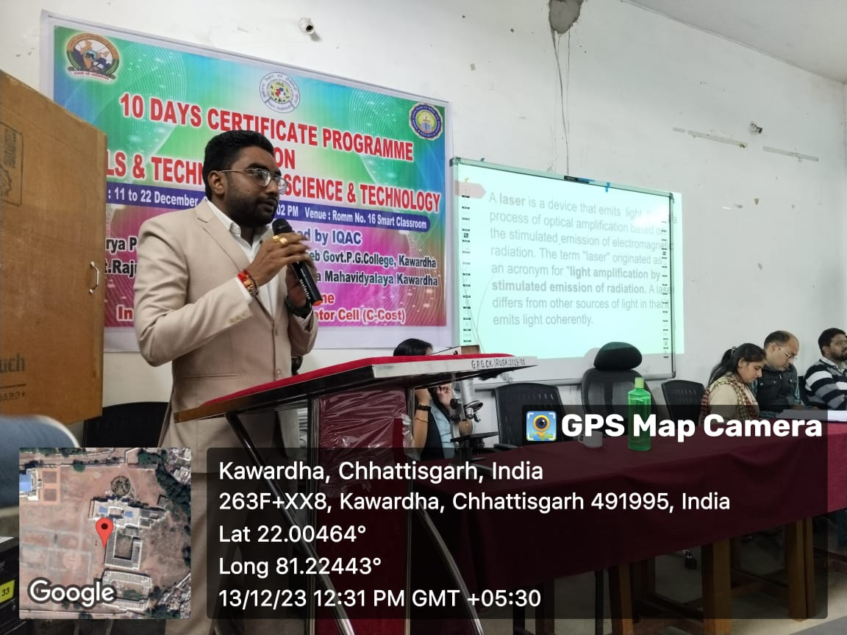
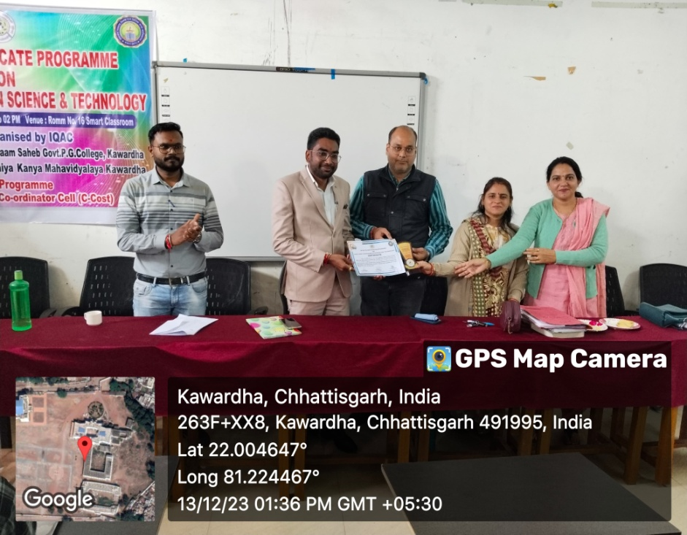
DAY THIRD 13.12.2023
LECTURE BY –Mr. Raja Jhariya, Asistant professor of Physics,
Govt. RVRS Girls College Kawardha (C.G.)
Topic- Laser Techniques

Slide 10
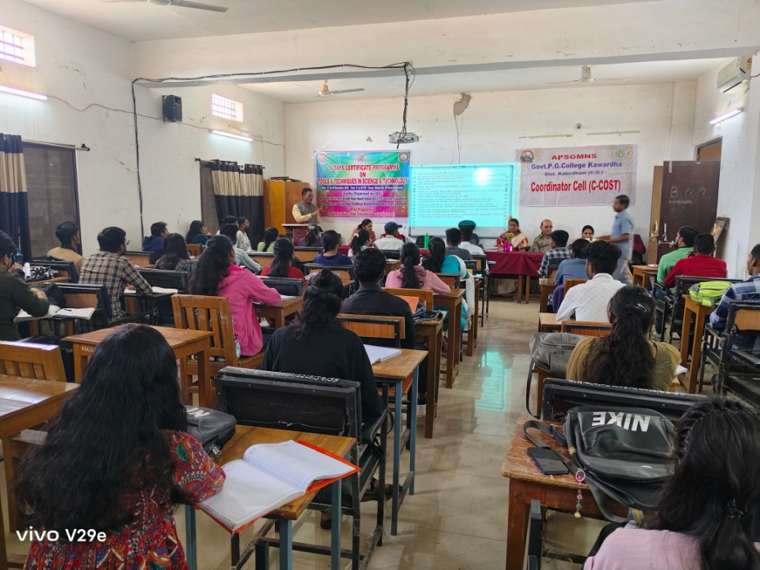
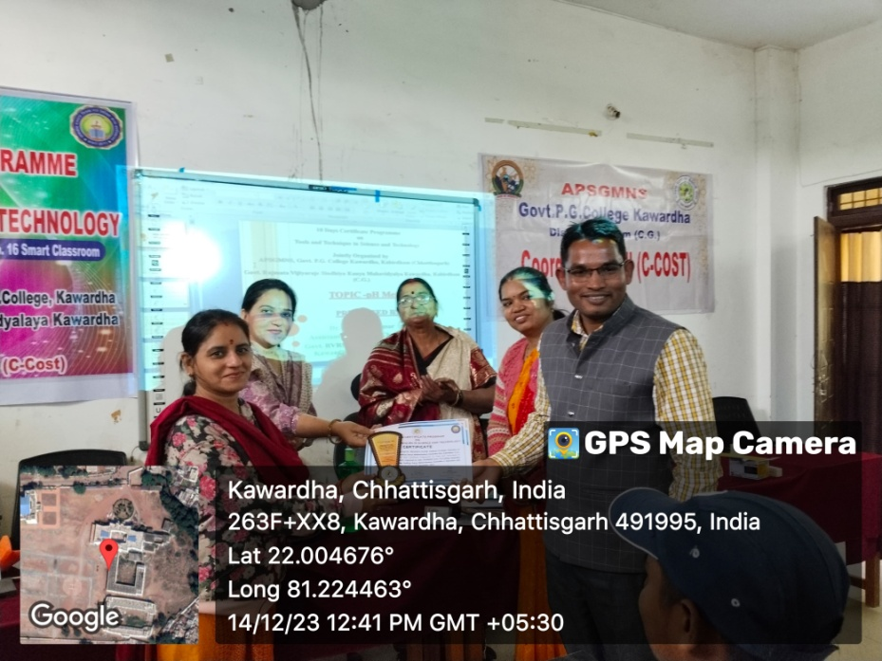
DAY FOURTH 14.12.2023
LECTURE BY – Dr. Birendra Kumar, Asistant professor of Chemistry,
Govt. RVRS Girls College Kawardha (C.G.)
Topic-pH Meter

Slide 11
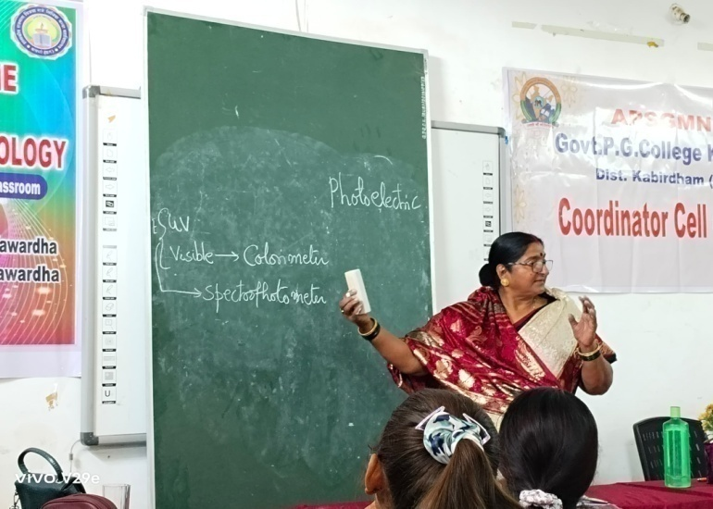
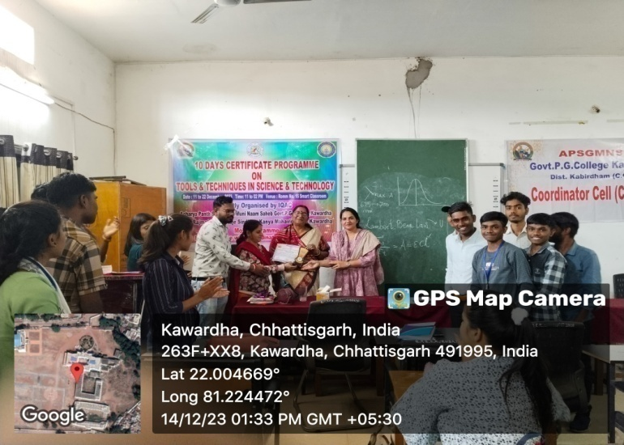
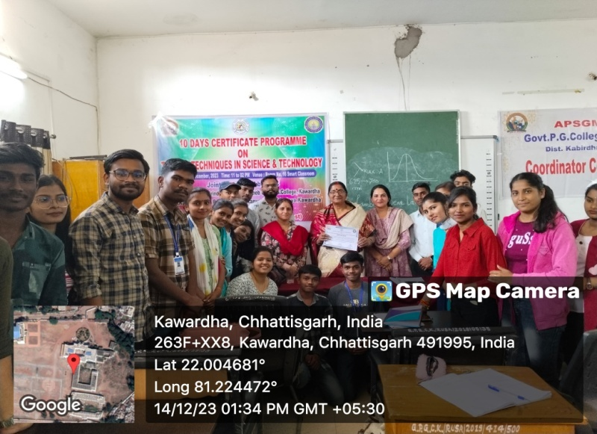
DAY FOURTH 14.12.2023
LECTURE BY – Dr. Birendra Kumar, Asistant professor of Chemistry,
Govt. RVRS Girls College Kawardha (C.G.)
Topic- Photometer

Slide 12
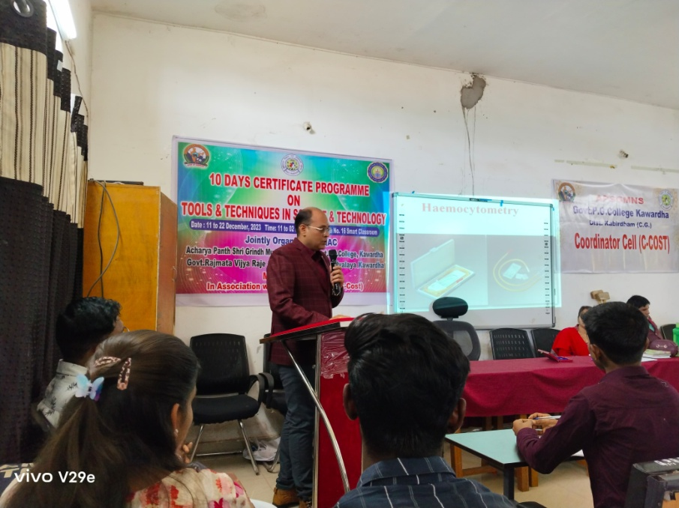
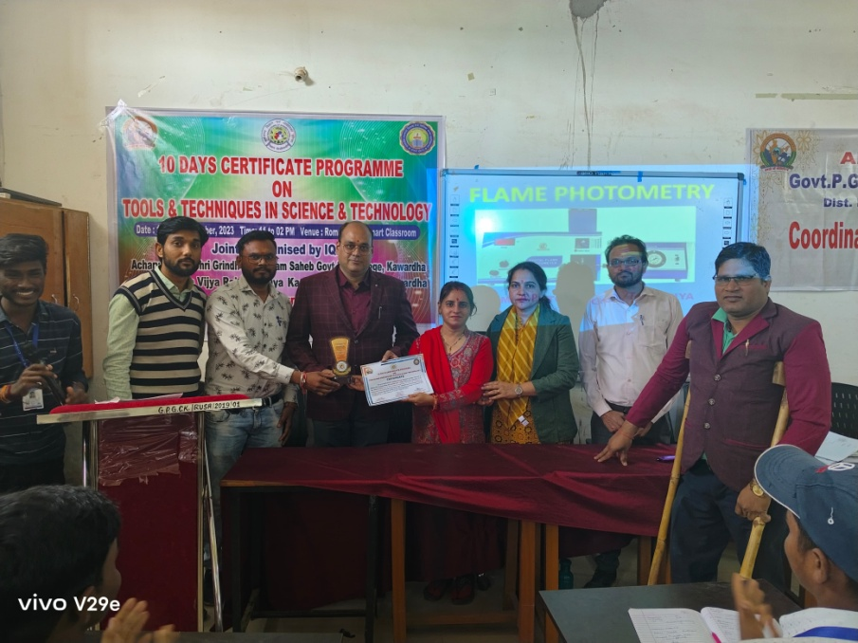
DAY FIVE 15.12.2023
LECTURE BY – Mr.Asit Mishra, Asistant professor of Zoology,
Govt. RVRS Girls College Kawardha (C.G.)
Topic- Techniques in Heamatology

Slide 13
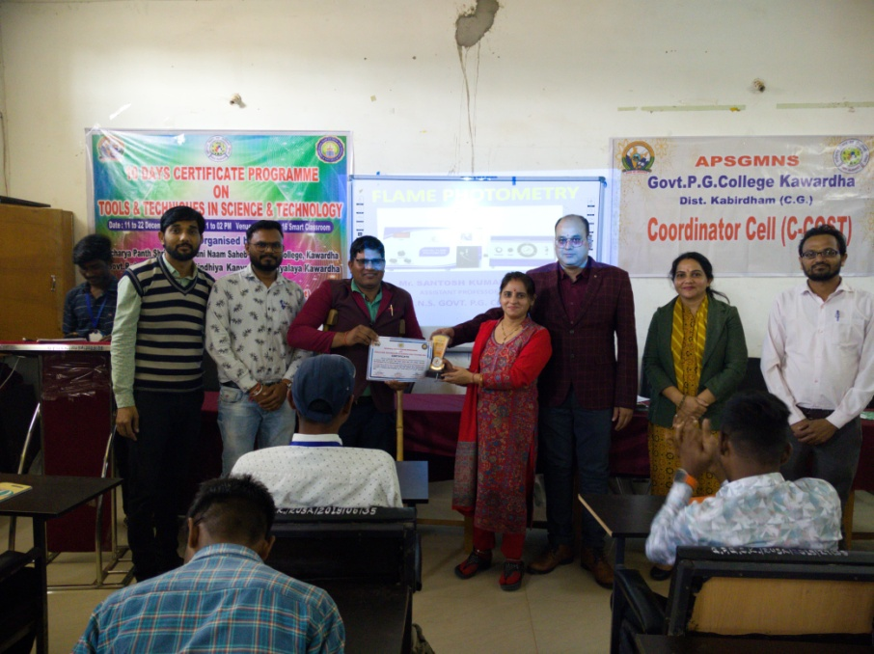
DAY FIVE 15.12.2023
LECTURE BY – Mr. Santosh Dahariya, Asistant professor of Chemistry,
APSGMNS Govt. P.G. College Kawardha (C.G.)
Topic-Flame Photometer

Slide 14
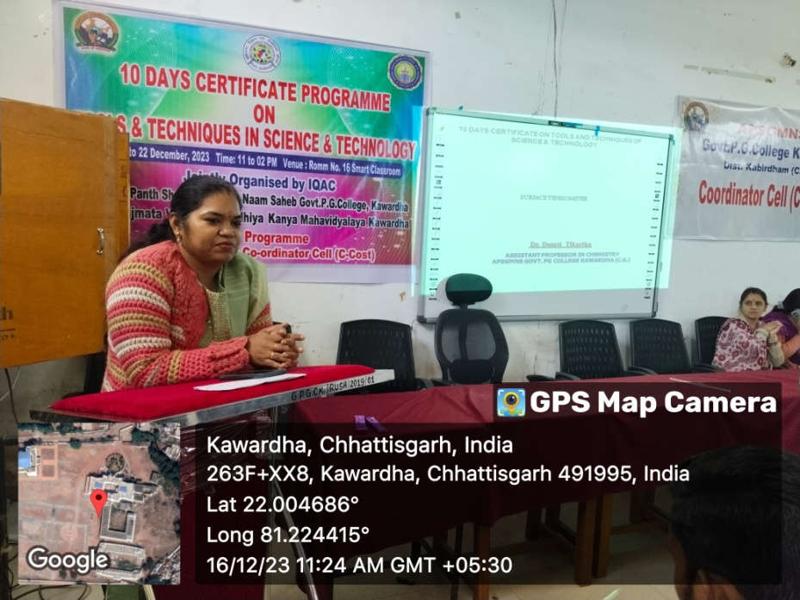
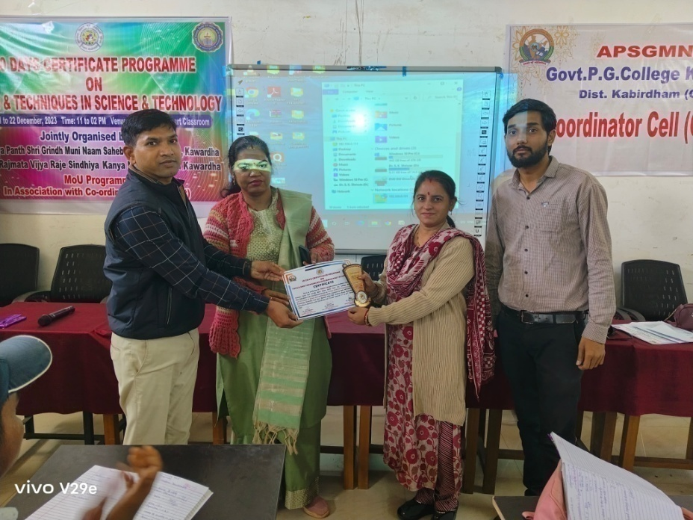
DAY SIX 16.12.2023
LECTURE BY – Dr. Deepti Jangde, Asistant professor of Chemistry,
APSGMNS Govt. P.G. College Kawardha (C.G.)
Topic- Surface Tentiometer

Slide 15
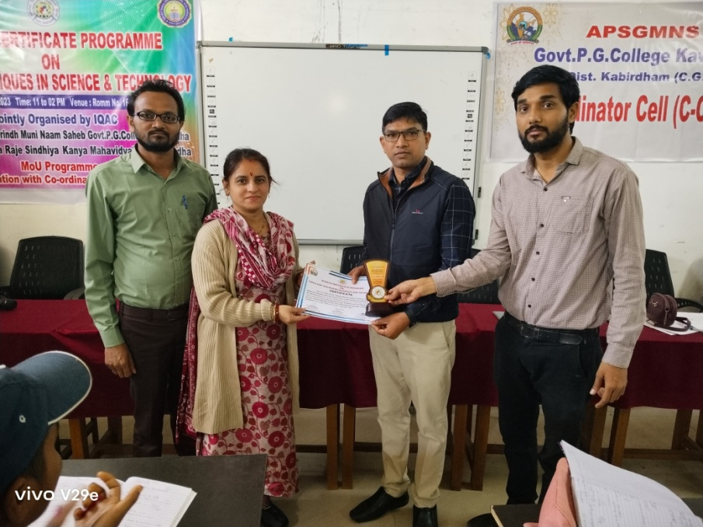
DAY SIX 16.12.2023
LECTURE BY – Dr. Sanjay Shrivas, Asistant professor of Chemistry,
Govt. College Pipariya Dist.- Kabirdham (C.G.)
Topic- Conductivity Meter

Slide 16
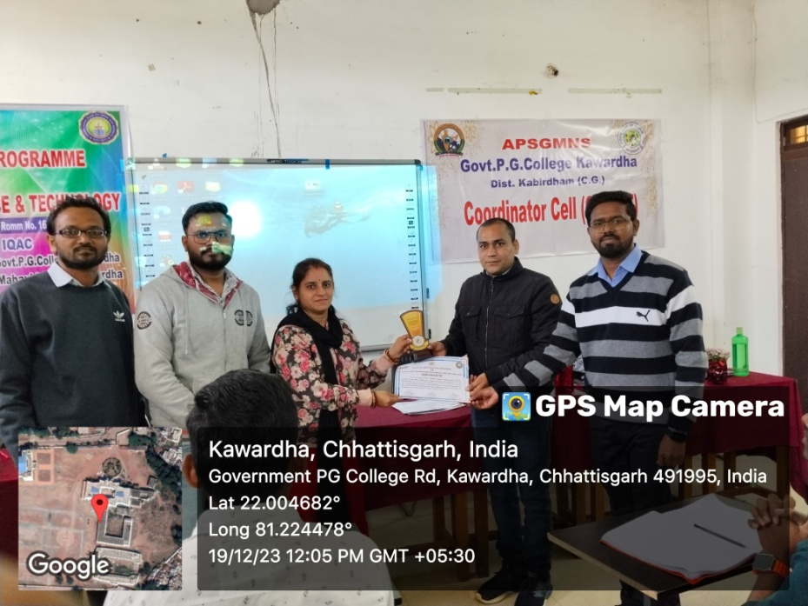
DAY SEVEN 19.12.2023
LECTURE BY – Dr. Mukesh Kumar Tyagi, Asistant professor of Chemistry,
Govt. College Pandatrai Dist.- Kabirdham (C.G.)
Topic- Spectrophotometer

Slide 17
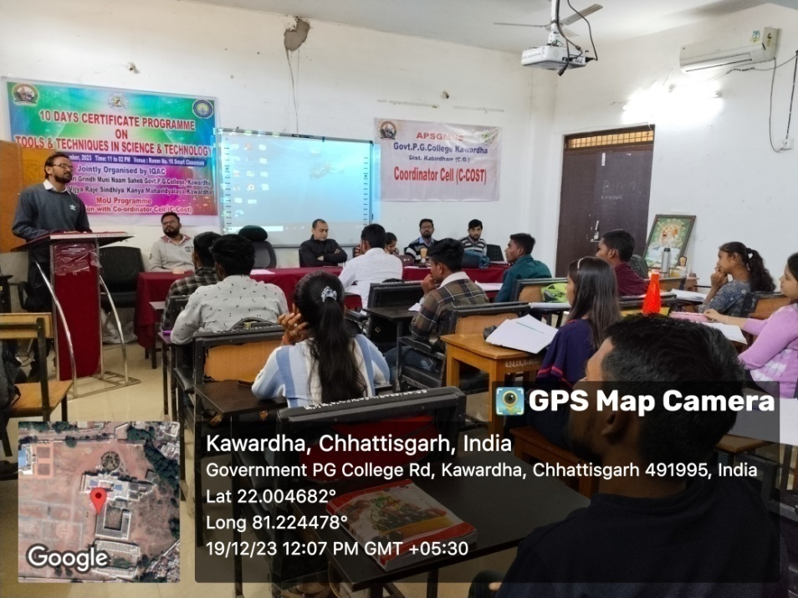
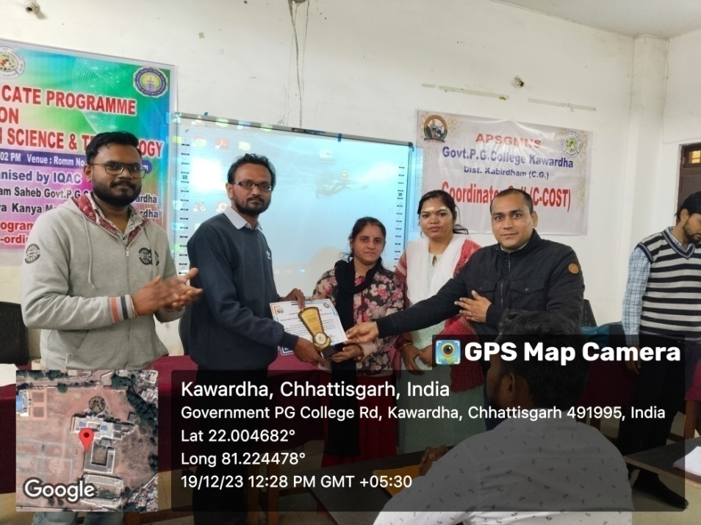
DAY SEVEN 19.12.2023
LECTURE BY – Mr. Tilak Sonwane, Guest lecturer of Botany,
APSGMNS Govt. P.G. College Kawardha (C.G.)
Topic-Plant Tissue Culture

Slide 18
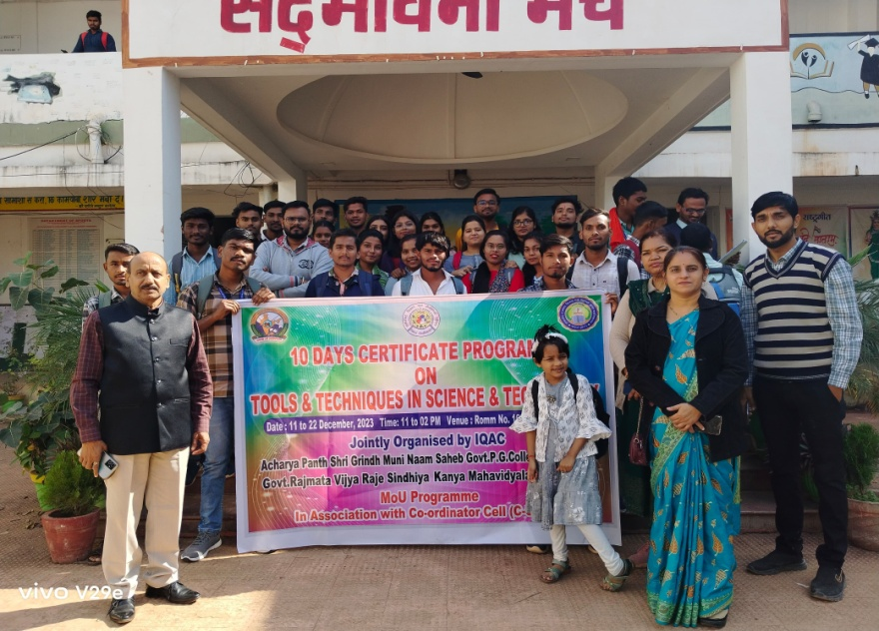
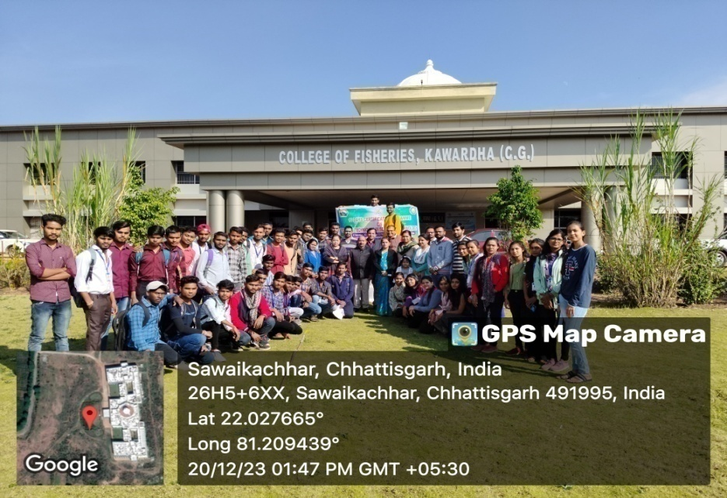
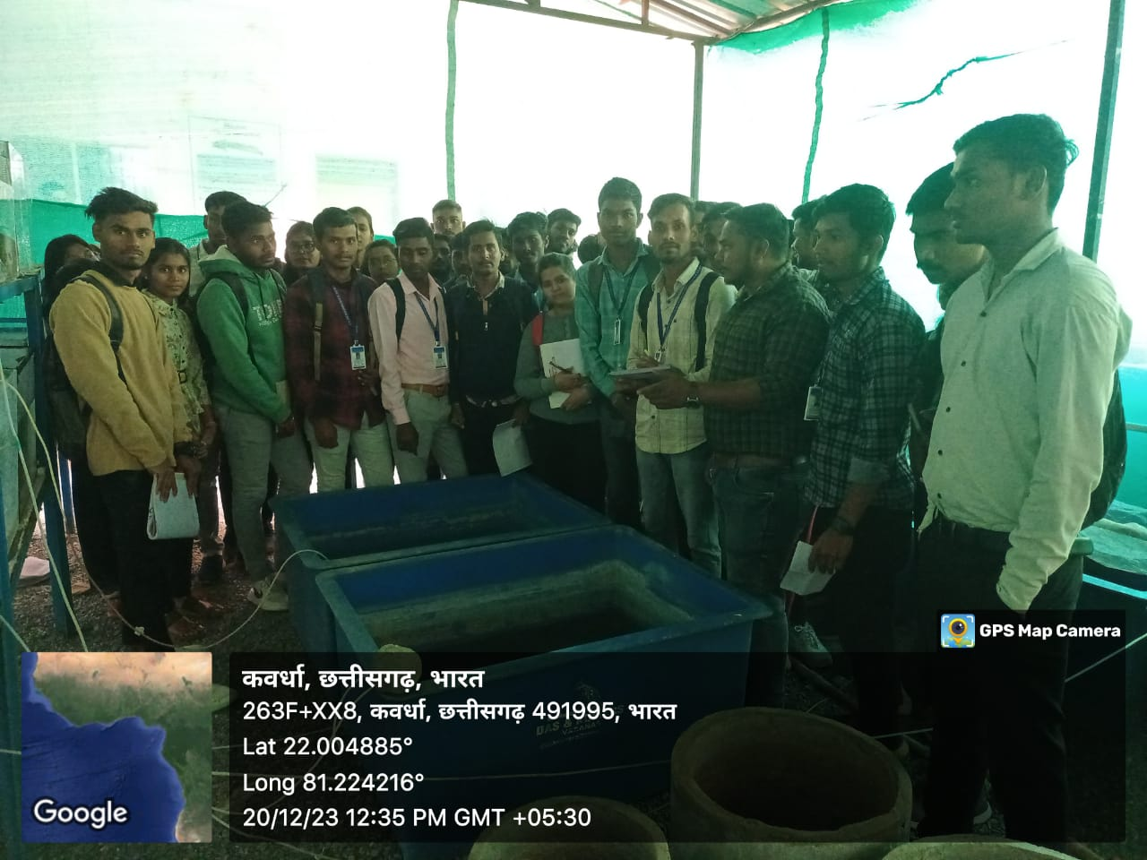
DAY EIGHT 20.12.2023
FISHRISH COLLEGE LABORATORY VISIT

Slide 19
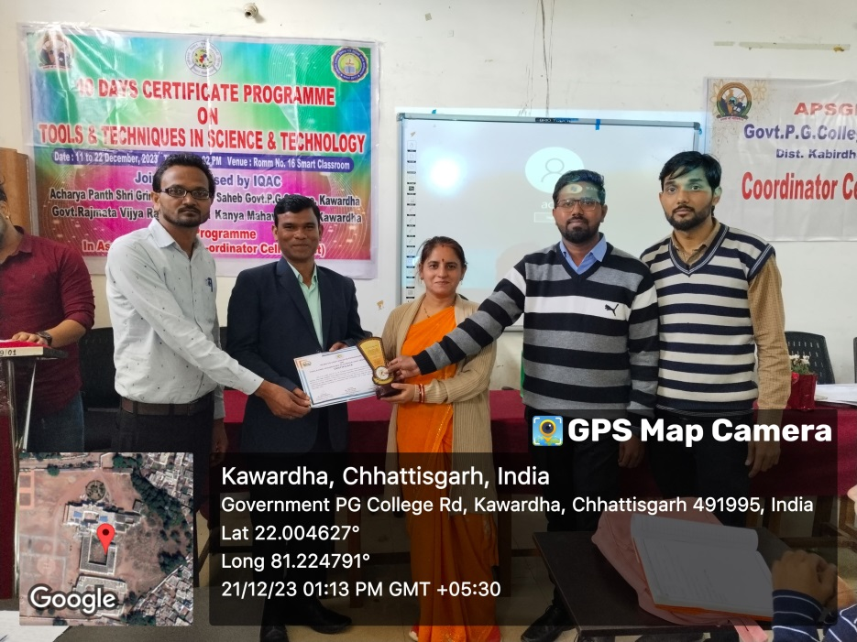
DAY NINE 21.12.2023
LECTURE BY – Dr. S.K. Tandan, Assistant professor of Computer Science,
Govt. RVRS Girls College Kawardha (C.G.)
Topic- A New Paradigm OF Learning

Slide 20
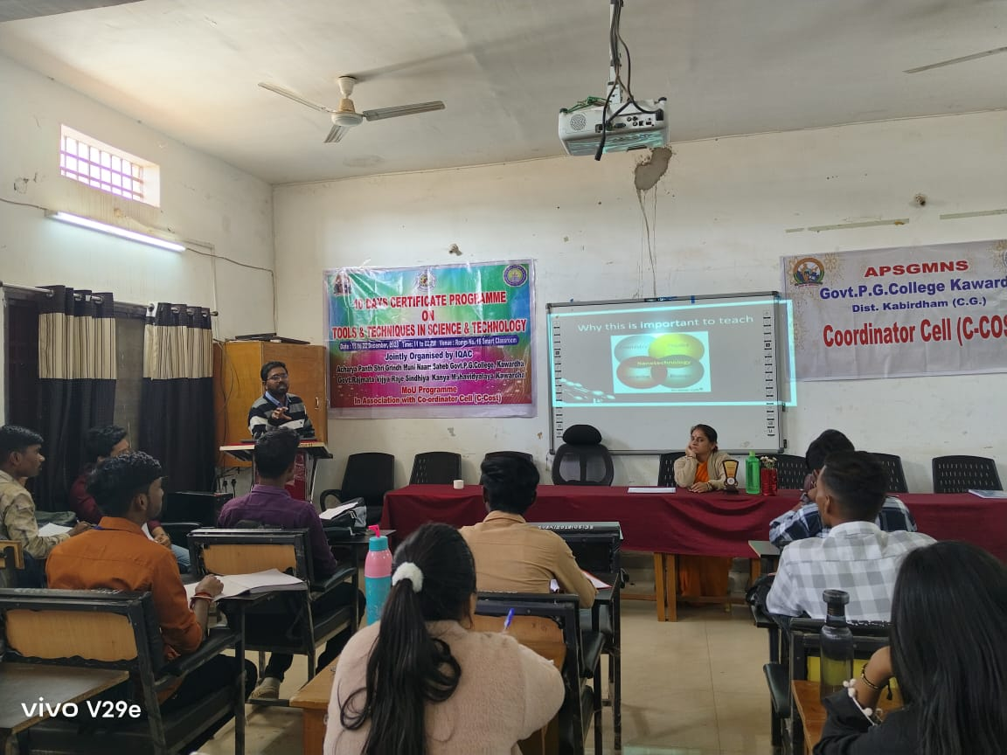
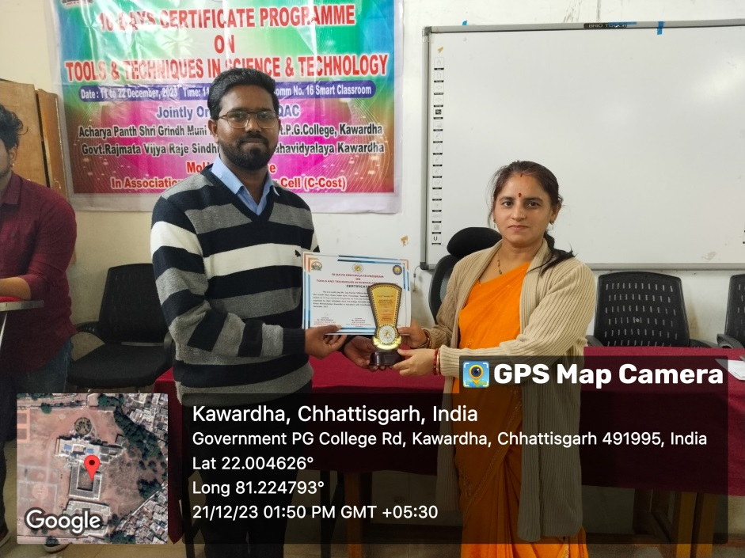
DAY NINE 21.12.2023
LECTURE BY – Mr. Jay Mehra, Assistant professor of Physics,
APSGMNS Govt. P.G. College Kawardha (C.G.)
Topic- Electron Microscope

Slide 21
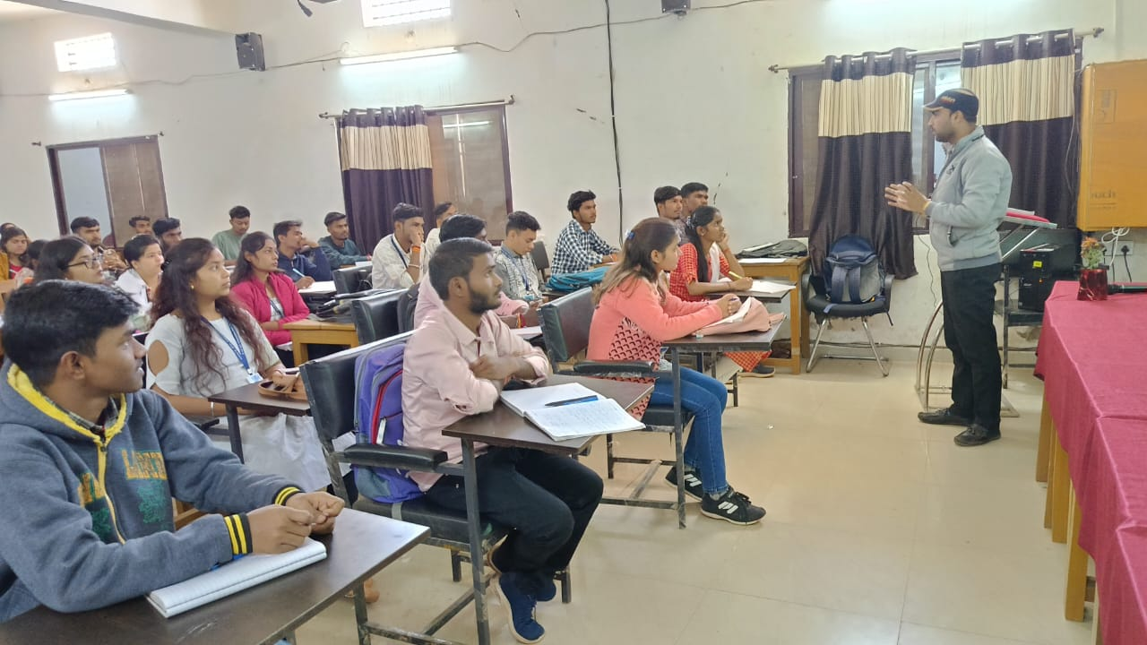
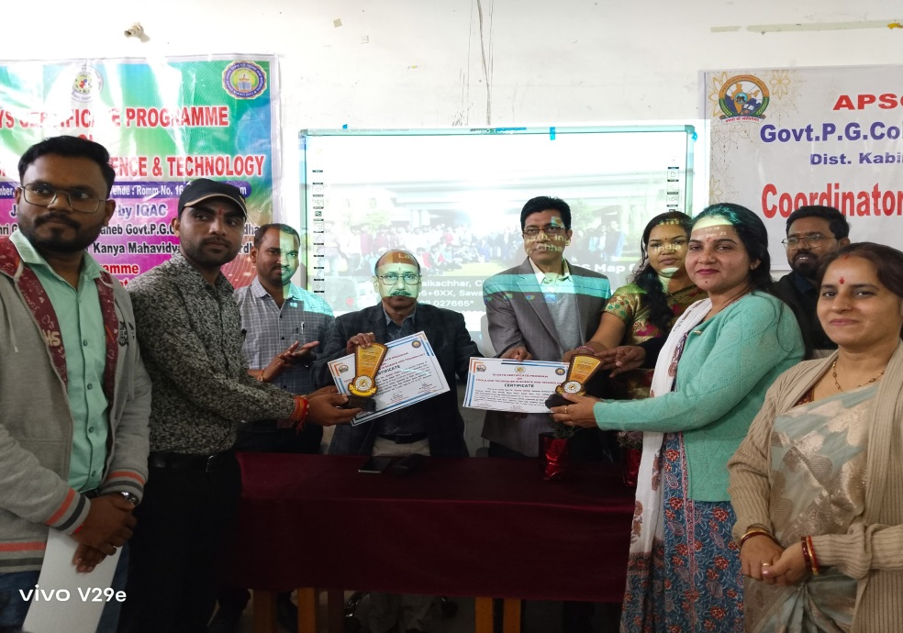
DAY TEN 22.12.2023
LECTURE BY – Mr. Umesh Rajput, Guest lecturer of Zoology,
APSGMNS Govt. P.G. College Kawardha (C.G.)
Topic- Chromatogaraphy

Slide 22
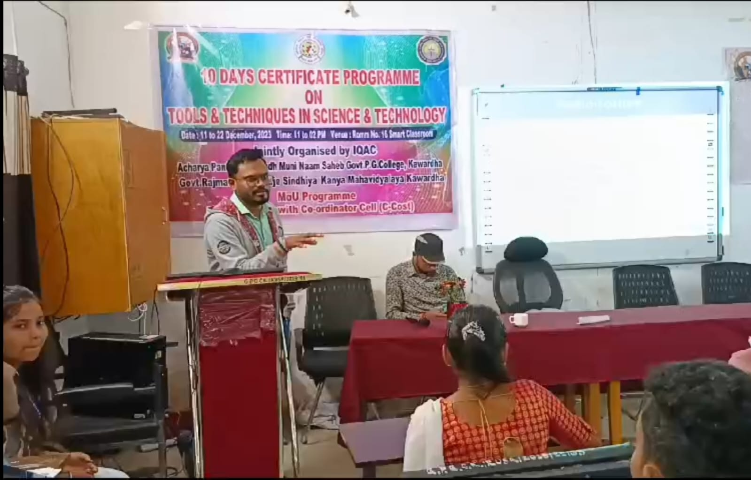
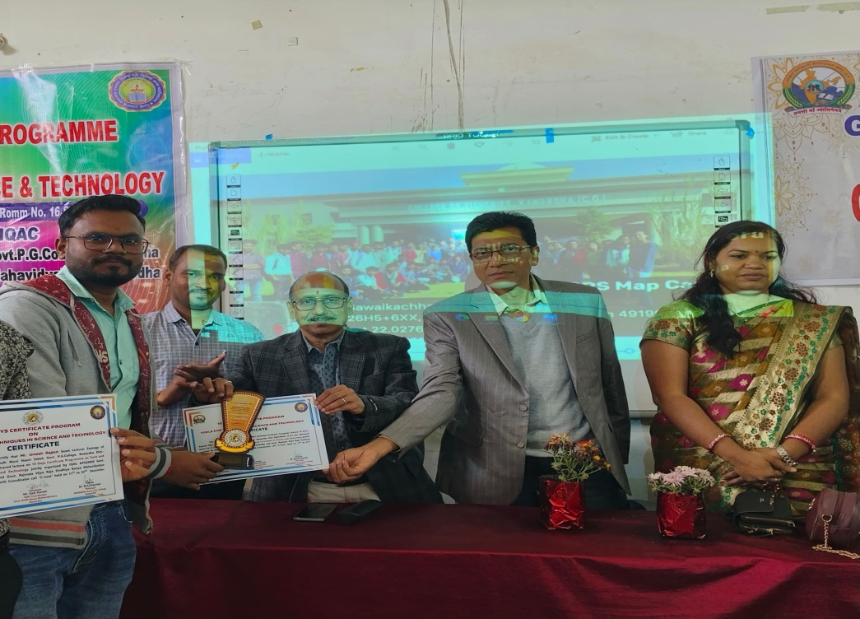
DAY TEN 22.12.2023
LECTURE BY – Mr. Ajay Kumar Diwakar, Guest lecturer of Microbiology,
APSGMNS Govt. P.G. College Kawardha (C.G.)
Topic- Radioisotope

Slide 23
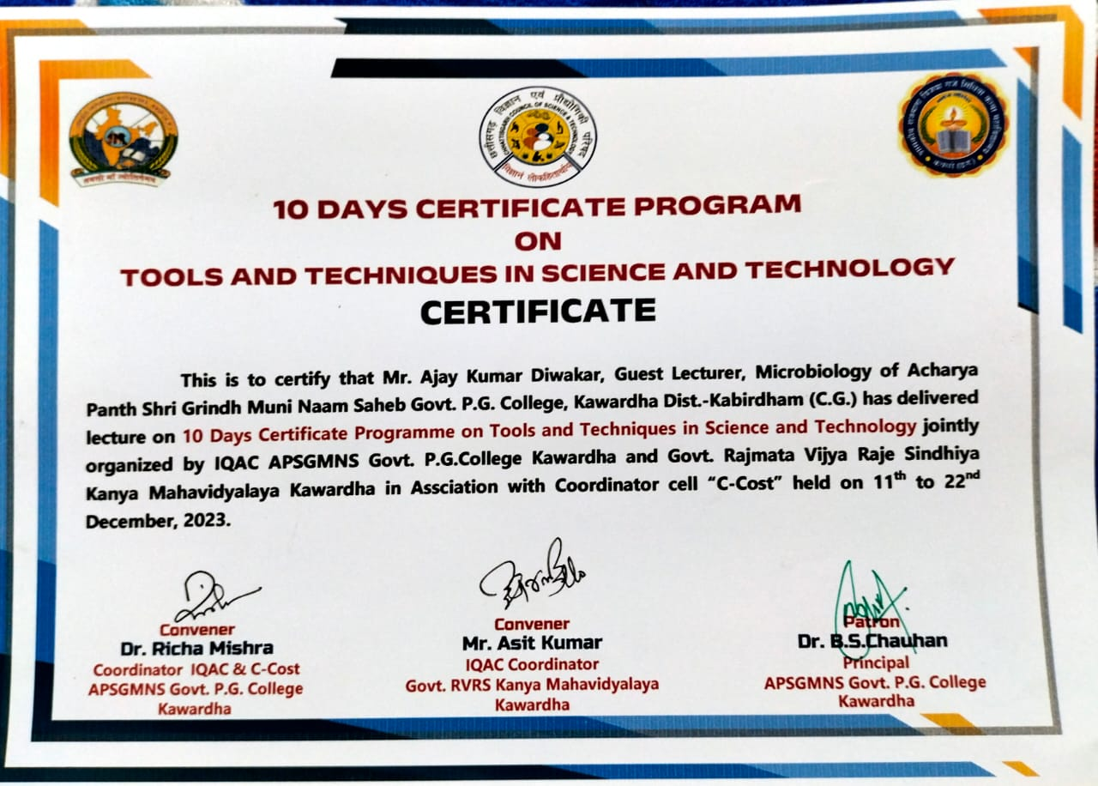

Slide 24
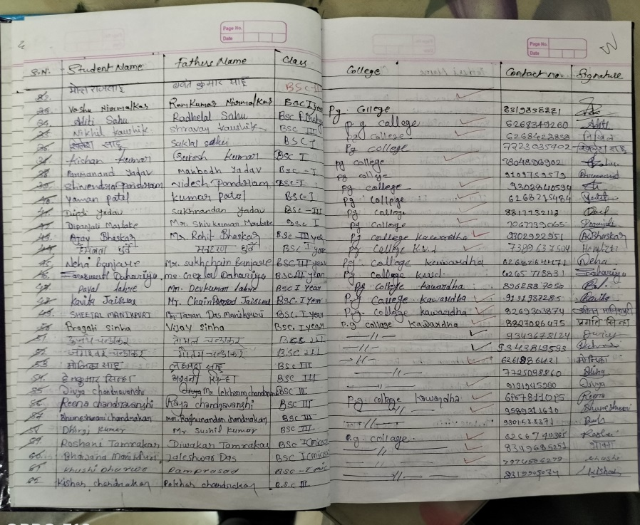
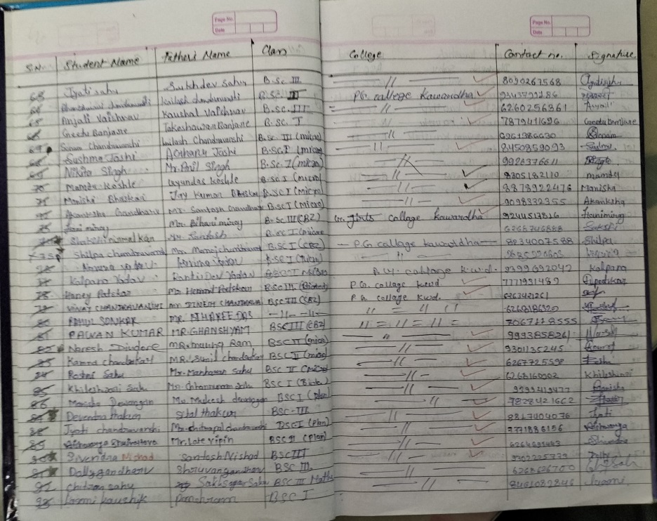
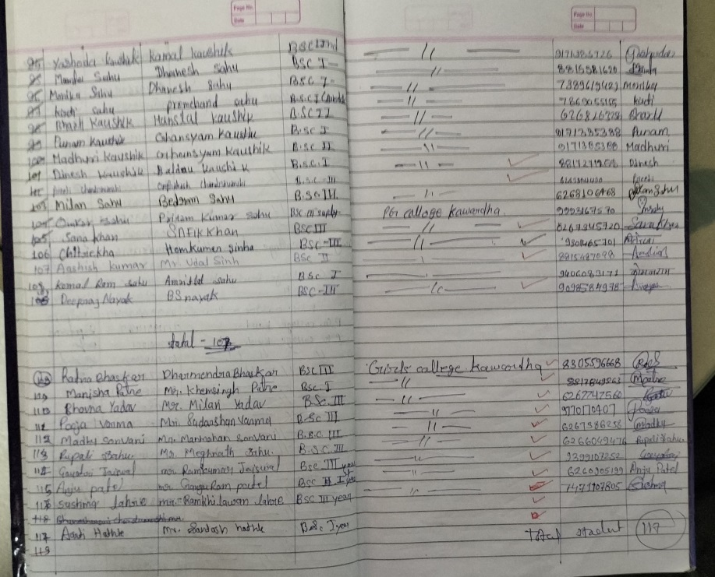

Slide 27
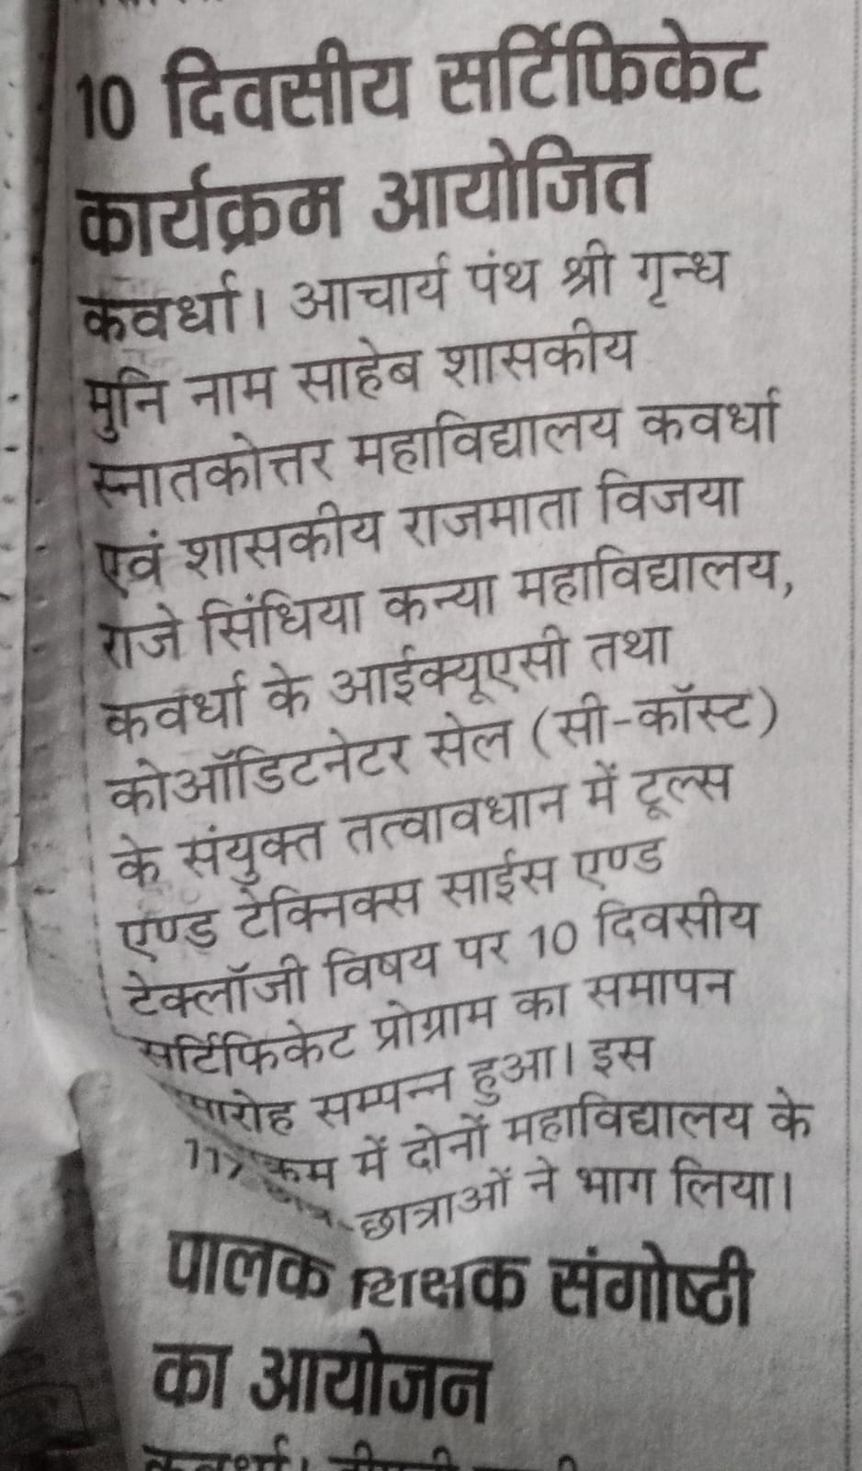
10 DAY CERTIFICATE PROGRAM

Slide 28
FEEDBACK
Dear students sharing you all the link of MCQ your participation is necessary after getting score you can get certificate...regards Coordinator🙏🏻 https://docs.google.com/forms/d/e/1FAIpQLSdEbLGuVuKahE96CfzNXwrC5doR5RH4A13SXsqTLblFAkjb3g/viewform?vc=0&c=0&w=1&flr=0
Dear students congratulations to you all for successfully completing this 10 days certificate programme I request you all to fill the feedback form as your feedback will be very important for us... Regards Coordinator
https://forms.gle/TKyJjmkx3y6scL2NA

